Slide 1
Lattice AI Agent Launch Toolkit

Slide 2
In this toolkit:
Lattice AI Agent for managers
Lattice AI Agent for all employees
Change management resources
  Suggested launch timeline
  Communication templates
AI resources
Additional Lattice AI features and resources (consider adding these into your employee and manager training materials to tell the full Lattice AI story)

Slide 3
Lattice AI Agent for managers

Slide 4
Why use Lattice AI?
01
Purpose-built for people programs
Lattice AI is trained on HR data and best practices a designed specifically for people management. It checks for bias and encourages actionable feedback.
02
Context aware
Uses our Lattice data for specific and accurate insights.
03
Embedded where you work
Integrated directly in review, feedback, and growth flows. No switching tools.
04
Get more value out of Lattice
Lattice captures rich qualitative data from your team. AI helps you do something with it.

Slide 5
Lattice’s AI Product Principles
Elevate human decision making.
They are not just repackaging data! Their AI tools are designed to empower leaders to get time back and make more informed decisions with access to next-level insights and content summaries.
Protect customer data.
They are GDPR and SOC Type II compliant and will continue to responsibly collect, use, and protect customer data. Learn more about how they keep your data secure.
Use best-in-class technology.
Their applications are powered by OpenAI’s leading machine-learning model, well-known for its ethical and technical credibility.

Slide 6
Using Lattice AI
Search and summarize Lattice product data.
Get quick answers to HR questions without hunting through our policies or waiting for HR.
Draft more objective and complete reviews and reduce recency bias.
Polish language, adjust tone, and eliminate bias in feedback.
Increase the frequency and quality of coaching moments.
Remember:
Personalize and validate any AI-generated content.
Use AI to save time — not skip conversations.
Focus on empathy, coaching, and human context.

Slide 7
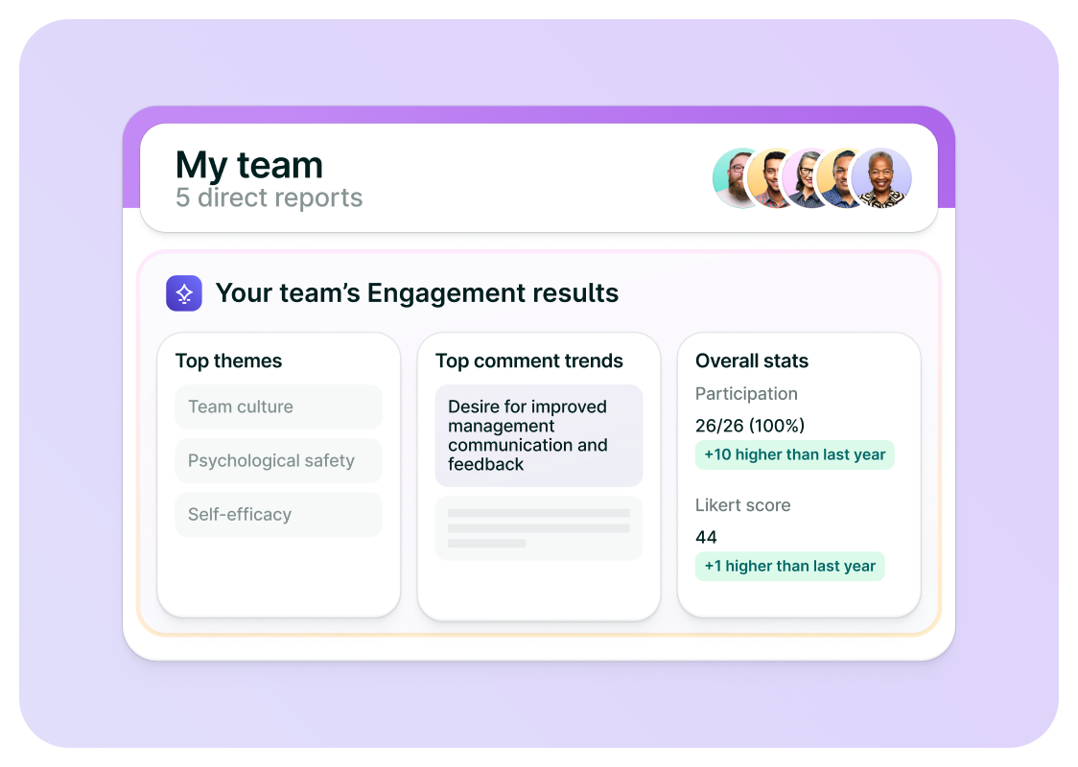
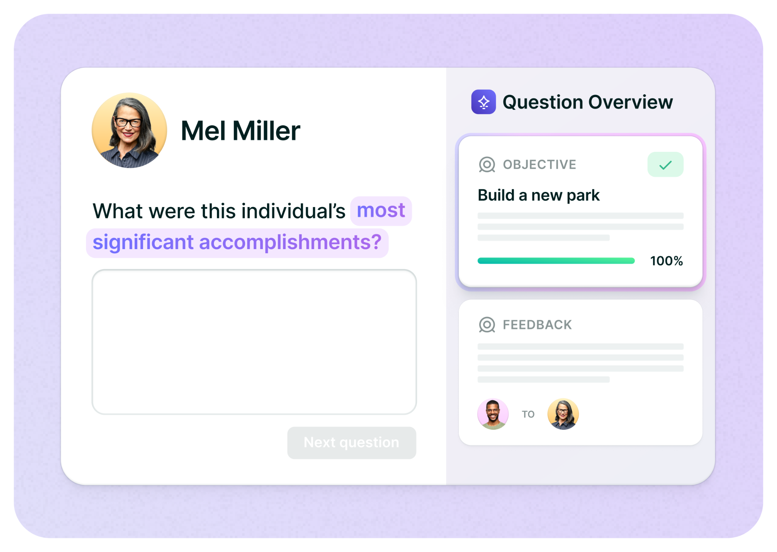
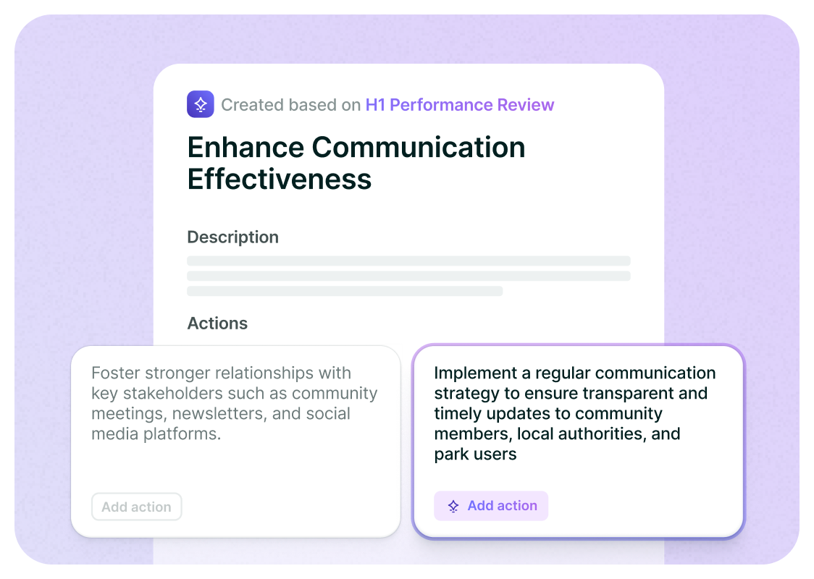




AI is integrated across the Lattice platform
Engagement
Performance
Grow
Writing Assist
Lattice AI Agent
Notes:
AI is Built Into the Platform
“You already own the full power of Lattice — AI is what brings that power to the surface. It unlocks the tools you already have.”
Feature List:
Feedback summaries to help managers write downward reviews
Engagement survey insights including key driver insights and comment summarization
Built-in writing assist in Reviews, Feedback, and Updates
Recommended Growth Areas based on past feedback and reviews to help employees build IDPs in Grow
Review packet summaries for managers to refer to during live calibration sessions
Feedback summaries for all review directions (peer, self, upward)
Lattice AI Agent helps HR scale, managers lead, and employees grow—by answering questions, surfacing insights, and delivering real-time coaching
Reinforce:
Lattice AI is not an extra module or upsell. It's already included in Reviews, Feedback, Grow, Engagement, and soon HRIS (via the AI Agent). The “activation” isn’t buying more — it’s using what’s already there
AI Reduces the Friction of Using Lattice
“AI helps people get value from Lattice without having to become power users. It shortens the distance between logging in and doing something meaningful.”
Real-world example:
In Reviews, AI summarizes peer/self/upward feedback so managers can write better, faster reviews — even if they’re not confident writers.
In Engagement, AI pulls top themes and sentiment trends to help HR get answers fast — without manually coding open comments.
AI Makes Adoption Easier for Everyone — Especially Managers
“If you’ve struggled with manager adoption in the past, AI is your unlock. It makes things faster, clearer, and more actionable — especially for first-time or reluctant managers.”
Real-world example:
In Grow, AI recommends development areas based on past reviews so employees don’t start with a blank page when building an IDP.
In Feedback and Updates, Writing Assist turns ideas into clear, actionable comments — reducing “blank page syndrome.”
Activation = Better Results, Not Just More Features
“The most successful Lattice customers are the ones using AI to drive action — not just to run a system. It’s how you go from filling out reviews to actually driving performance.”
Reinforce:
Customers using Feedback summaries + Engagement AI see more feedback go up and survey insights actioned faster.
Grow adoption increases when AI recommends IDP actions based on feedback.

Slide 8
🚨EDIT this slide if there is anything else you’d like to highlight!
How we plan to use the Agent
Quickly answer HR, policy, and how to use Lattice questions
Make the most out of Lattice product data (you can search & summarize data from Lattice!)
Help YOU 🫵 be more effective leaders with insights, coaching, and best practices
Empower employees to own their careers with development coaching
Ultimately, encourage better utilization of Lattice tools and processes (such as 1:1s)

Slide 9
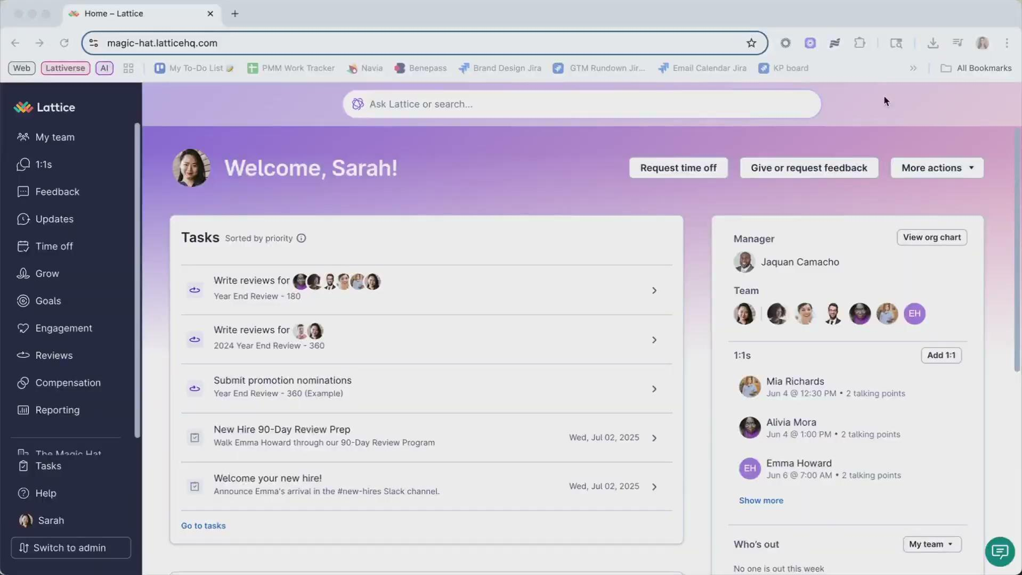
Watch a demo

Slide 10
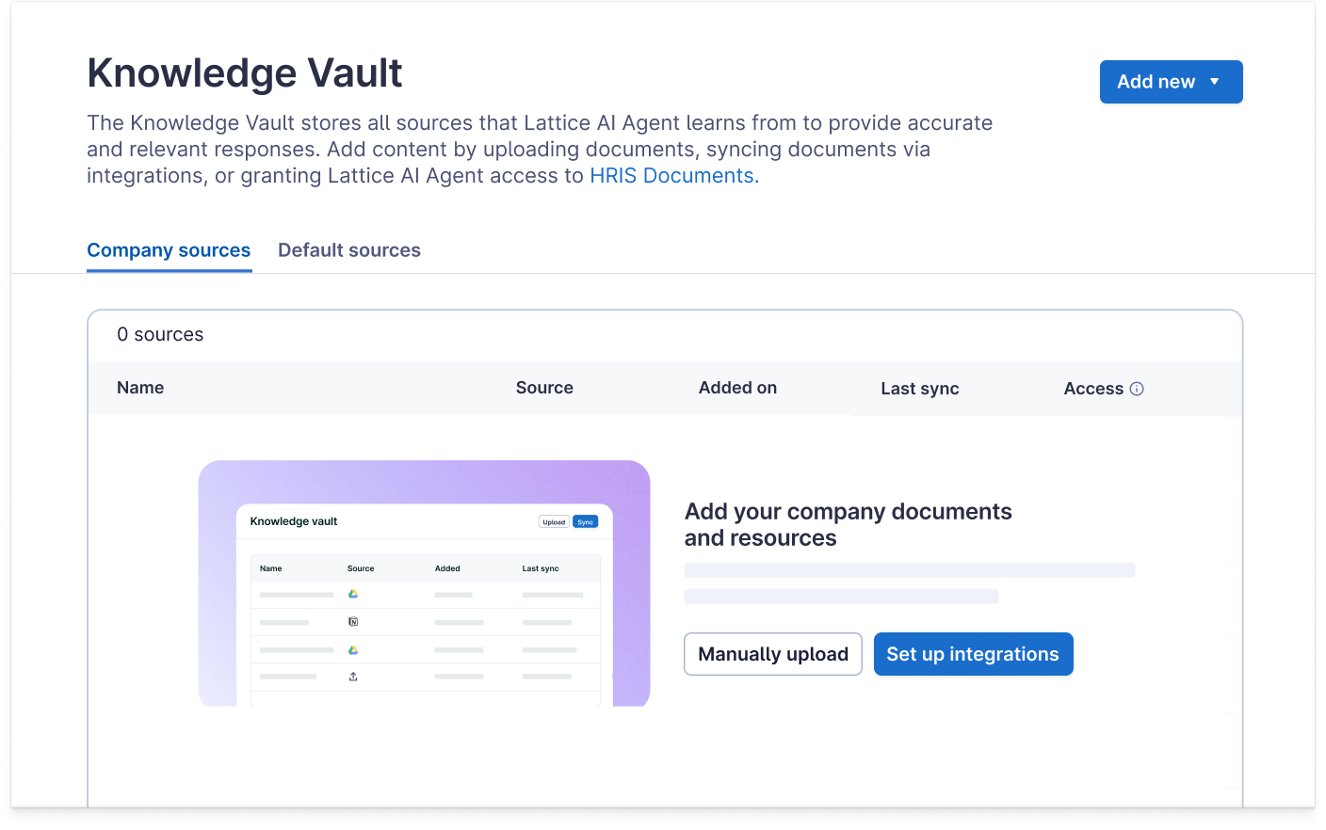

🚨EDIT this slide to reflect what you’ve shared with the Agent!
What our AI Agent is trained on
We’ve uploaded and synced policies into the Agent’s Knowledge Vault:
Employee handbook / HR policies
Career / Grow tracks
Benefit guides
Office information
Career development programs
Compensation philosophies
Manager best practices
Talent processes
Onboarding/New Hire Guides
Compliance documents

Slide 11
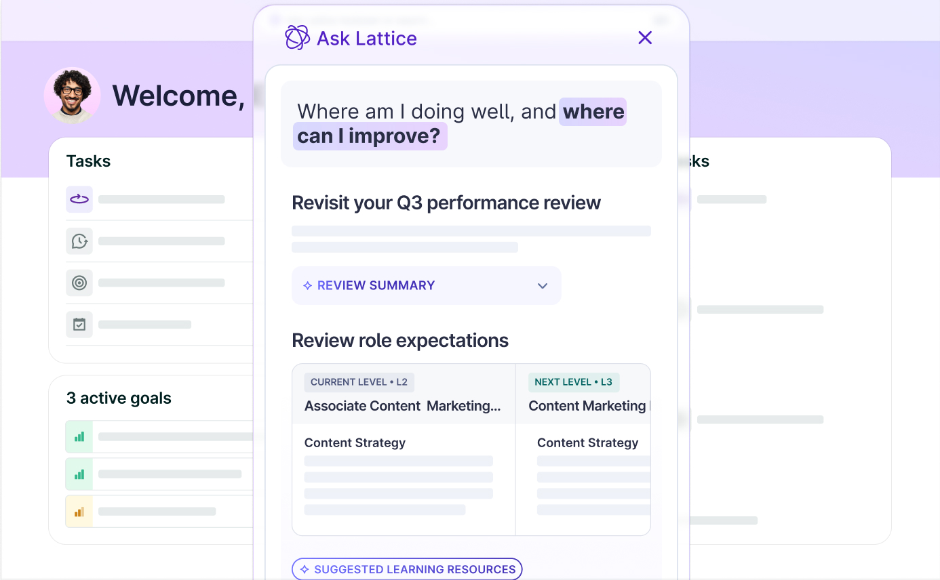
Using the Lattice AI Agent
Search and chat with Lattice data to enhance your growth and identify focus areas.
Based on my feedback from the last 6 months, where should I focus my growth?
Summarize the themes of my 1:1s with my manager from the last month.
Get answers to your sensitive or burning questions without needing to hunt through policies or wait for HR.
What are our medical benefits?
How do I apply for parental leave?
What do I need to do to access a different office location?
How much is the L&D stipend?
How do I update my direct deposit information?
How do I get a promotion?

Slide 12

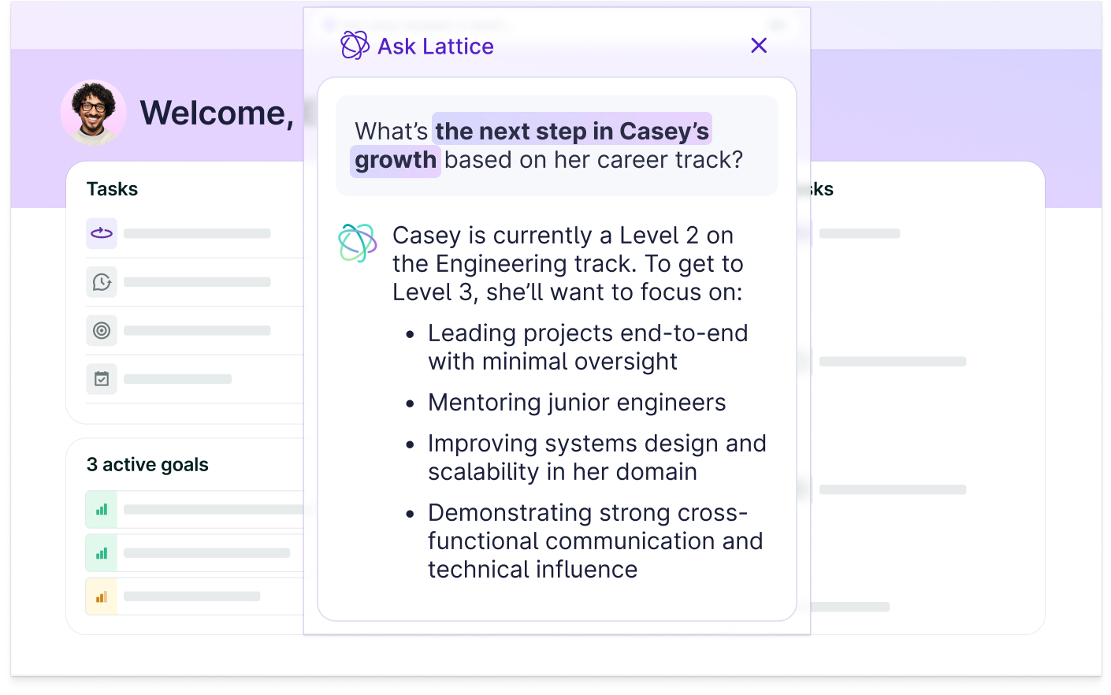
How the Agent fits into your workflow
Use the Agent to become a more effective leader.
Improve team performance & engagement
Navigate difficult conversations
Identify coaching moments and performance risks early
Who on my team hasn’t received feedback this quarter?
Summarize the updates from my team over the last week
What did I talk about in my last 1:1 with [employee]?
What feedback has [employee] received in the last 6 months?
How do I recommend an employee for a promotion?
How should I provide feedback to my employee?
✨Check out this resource from Lattice for tips on AI prompt writing for managers

Slide 13
What to watch out for when using AI
Over-relying on AI: Always review, personalize, and edit AI output.
❗ Losing your voice: Feedback should still sound like *you*.
❗ Misusing tone suggestions: Don’t hide tough messages behind 'friendly' language.
❗ Assuming AI knows the full context: Add team- or person-specific details.
❗ Using AI for sensitive or private data: Keep personal issues or confidential info out of AI tools.

Slide 14
What we need from you
Start using the Lattice AI Agent today
Share examples of ways you’ve prompted the Agent for insights into your team:
🤩 What’s a prompt that really impressed you?
🤓 What kinds of insights have you been able to glean from the Agent?
Demonstrate good behaviors for your team by tracking 1:1s, submitting feedback, or posting a public update
The more you encourage your team to use Lattice, the better the Agent will be able to support you as a manager!
When the time comes, encourage your team to try out the Agent

Slide 15
Lattice AI Agent for all employees

Slide 16
Why use Lattice AI?
01
Purpose-built for people programs
Lattice AI is trained on HR data and best practices a designed specifically for people management. It checks for bias and encourages actionable feedback.
02
Context aware
Uses our Lattice data for specific and accurate insights.
03
Embedded where you work
Integrated directly in review, feedback, and growth flows. No switching tools.
04
Get more value out of Lattice
Lattice captures rich qualitative data from your team. AI helps you do something with it.

Slide 17
🚨EDIT this slide if there is anything else you’d like to highlight!
How we plan to use the Agent
Quickly answer HR, policy, and how to use Lattice questions
Make the most out of Lattice product data (you can search & summarize data from Lattice!)
Empower you to own your career development with personalized coaching

Slide 18
Lattice’s AI Product Principles
Elevate human decision making.
They are not just repackaging data! Their AI tools are designed to empower leaders to get time back and make more informed decisions with access to next-level insights and content summaries.
Protect customer data.
They are GDPR and SOC Type II compliant and will continue to responsibly collect, use, and protect customer data. Learn more about how they keep your data secure.
Use best-in-class technology.
Their applications are powered by OpenAI’s leading machine-learning model, well-known for its ethical and technical credibility.

Slide 19
Using Lattice AI
Search and summarize Lattice product data.
Get quick answers to HR questions without hunting through our policies or waiting for HR.
Draft more objective and complete reviews and reduce recency bias.
Polish language, adjust tone, and eliminate bias in feedback.
Increase the frequency and quality of coaching moments.
Remember:
Personalize and validate any AI-generated content.
Use AI to save time — not skip conversations.
Focus on empathy, coaching, and human context.

Slide 20
Using the Lattice AI Agent
Search and chat with Lattice data for personalized development recommendations:
Based on my feedback from the last 6 months, where should I focus my growth?
Summarize the themes of my 1:1s with my manager from the last month.

Slide 21
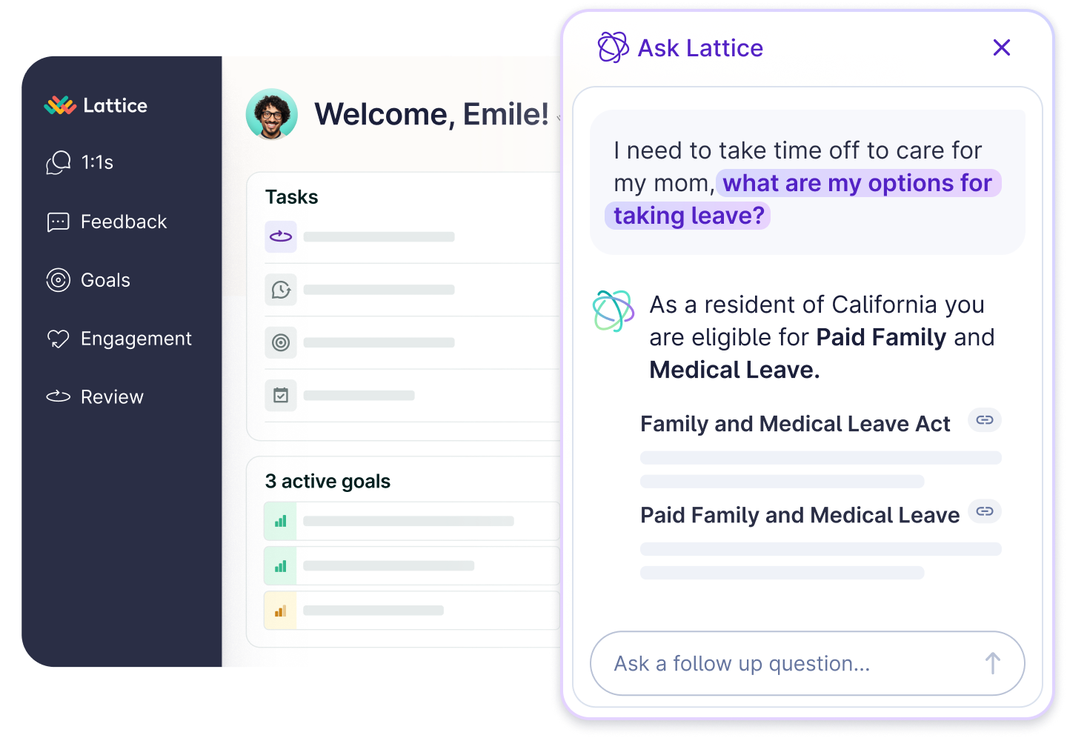
🚨EDIT this slide if the sample questions do not reflect the resources that you’ve trained the Agent on
Using the Lattice AI Agent
Get answers to your sensitive or burning questions without needing to hunt through policies or wait for HR.
What are our medical benefits?
How do I apply for parental leave?
What do I need to do to access a different office location?
How much is the L&D stipend?
How do I update my direct deposit information?
How do I get a promotion?

Slide 22
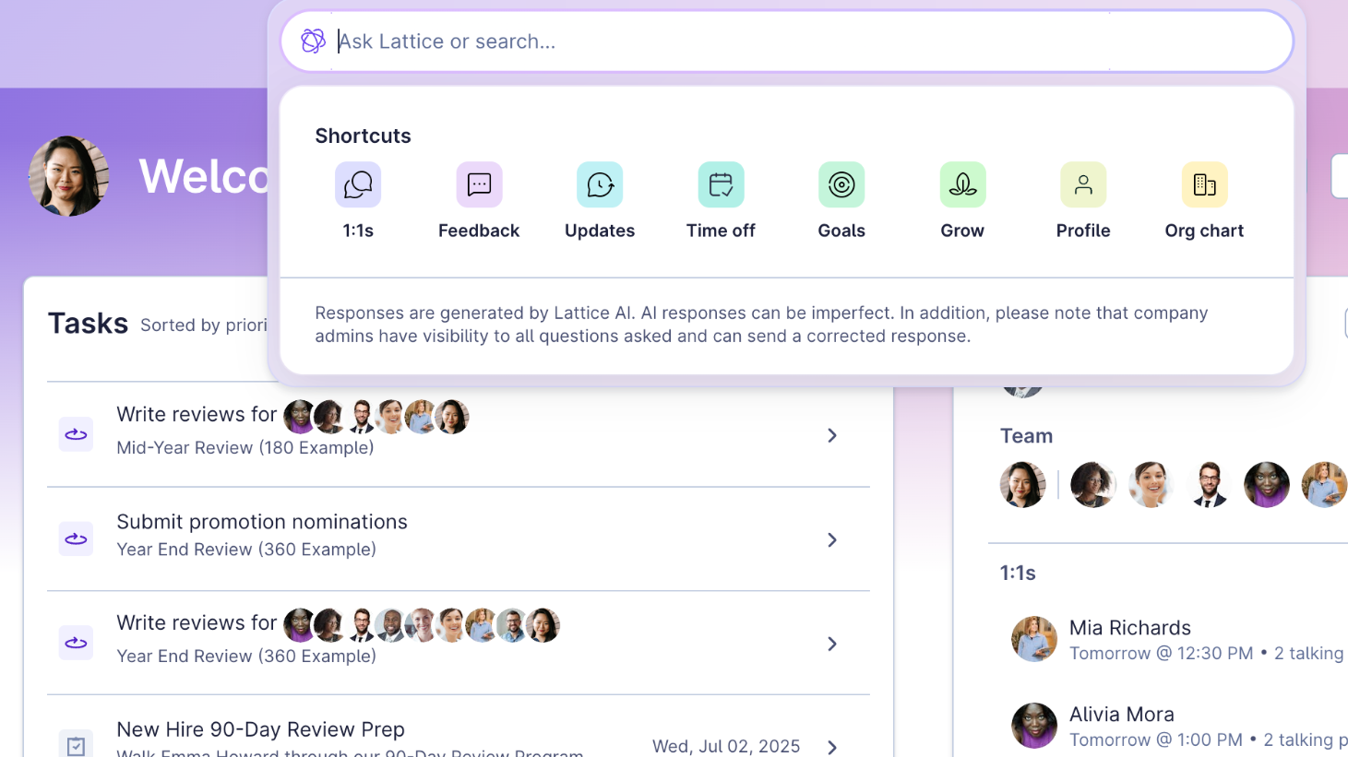
Using the Agent is easy!
How to use the Agent:
From anywhere on Lattice, select the Ask Lattice or search bar at the top of the page.
Enter your question > Select the arrow or press enter.
Ask any follow-up questions.
Need more info?
Once answered, select Source to view the document from which the Lattice AI Agent pulled the answer.
Upvote or Downvote the answer to share feedback with your Lattice admins.

Slide 23
Watch a demo

Slide 24
Change management resources
Notes:
What are the sticky elements?
Consider this... In knowledge vault. Values, behaviors - how does this person exhibit our values? Categories of resources that you might need to create

Slide 25
A winning strategy for change
…. and what to avoid
Change Management with Lattice
Success Indicators
Clarity on “the Why”
Ability to tie the Agent back to broader business objectives including:
  Manager effectiveness
  Employee development
Manager buy-in and role modeling
Clear guidelines for employees to use the Agent
Roadblocks to avoid
Lack of clear comms (dates, purpose, training, expectations, suggested uses)
Lack of manager buy-in

Slide 26
Change Management Overview
Establish Clear Objectives
Engage Stakeholders
Training & Enablement
Piloting & Feedback
Track Progress & Celebrate Success
What are our adoption goals?
Why is AI important to our organization?
Host a manager enablement session ahead of launch
Identify AI champions at the org
Host a manager session ahead of launch
Introduce the Agent during an All Hands or team meetings
Share resources via email or slack
Set up a Q&A session
Roll out to a small test group first and collect feedback on responses (People team, ERGs, Managers) HC article here
Have AI champions share their favorite questions in an All Hands or Slack channel
Use the Dashboard to monitor question trends, identify champions and celebrate success.

Slide 27
Suggested launch timeline
Week 1
Week 2
Week 3
Week 4
Week 5
Admin configuration
Small group testing & feedback
Manager training
Employee comms & training

Slide 28
Launch email for managers
Subject: Meet your new Lattice AI Agent — built to help you become a more effective leader 🚀
Hi team,
We’re excited to introduce the Lattice AI Agent, rolling out next week! Think of it as your HR angel sitting on your shoulder, but inside Lattice! It can help you spend less time tracking down information and more time coaching and supporting your team.
The AI Agent can:
Answer questions about policies at our org
Surface key themes from 1:1s, Updates, and Feedback
Help you make more informed, proactive decisions as a manager
You’ll see a new search bar at the top of Lattice. That’s your starting point — just ask it questions about your team’s data or company policies. Watch this demo to see the Lattice AI Agent in action.
It can also address questions that you or your teams may have like:
How do I update my direct deposit information?
How do I get a promotion?
Based on my feedback from the last 6 months, where should my employee focus their growth?
Summarize the themes of my 1:1s with my manager from the last month.
Why it matters to you:
Save time: Point your team to the AI Agent instead of fielding policy questions
Coach smarter: Get insights that help you lead more effectively
Get ahead of issues: Use your team’s feedback and behavior patterns to act proactively
The more you and your team use Lattice for 1:1s, Feedback, and Updates, the more powerful and personalized the AI Agent becomes. If you haven’t already, now’s a great time to get those set up. Have questions? Reach out via [contact person/help channel].
— [Your HR/People Team Name]

Slide 29
Launch email for all employees
Subject: Meet your new Lattice AI Agent 🚀 — built for your growth
Hi team,
We’re excited to roll out the Lattice AI Agent next week — your new go-to for instant answers and personalized growth guidance, right inside Lattice! Think of it as your personal coach + HR assistant, always on and ready to help.
Quickly answer questions like:
How do I apply for parental leave?
What’s the process for getting a promotion?
Where do I find our medical benefits?
Help you reflect and grow with prompts like:
What should I focus on based on my feedback?
Summarize the themes of my 1:1s with my manager
What skills have I been recognized for recently?
Just type your question into the new search bar at the top of Lattice — the AI Agent will take it from there. Watch this demo to see the Lattice AI Agent in action.
Why it’s awesome:
Save time: No more digging through docs or pinging HR
Stay informed: Get quick answers about your benefits, policies, and goals
Grow smarter: Get feedback-based insights to focus your development
The more you use Lattice for 1:1s, Feedback, and Updates, the more personalized your AI Agent becomes. If you haven’t started yet, this is the perfect time to dive in. Have questions? Reach out via [contact person/help channel].
— [Your HR/People Team Name]

Slide 30
AI resources

Slide 31
Sources that you may want to consider building out for your Knowledge Vault
Values & Behavioral Anchors
Purpose: Ground coaching in what matters most culturally.
Company Values + Observable Behaviors Matrix
Values with examples at different levels
Competency & Capability Frameworks
Purpose: Help employees and managers understand what "great" looks like by level and function.
Role-Specific Competency Frameworks
Define behavioral and results expectations
Leadership Competency Model
Career Pathways & Growth Guides
Purpose: Equip the Agent to guide users in career planning or identifying skill gaps.
Career Ladders including expectations and impact for progressing
Promotion Criteria
Growth Planning Tools with prompts to guide planning such as “How do I measure growth?”
Feedback & Development Best Practices
Purpose: Provide real-time coaching around giving feedback and setting goals
Feedback framework and examples
Growth-oriented 1:1 templates
Goal setting framework with examples

Slide 32
📚 Additional AI Resources & Shareables
Lattice Resources:
Quick Start Guide
Lattice AI: Performance and Feedback - Enablement Slides [MAKE A COPY]
AI Walkthrough Loom
How To Transform Your HR Strategy With AI | Ebook | Lattice
'25 Lattice AI Tearsheet_shortened.pdf
Webinar - AI Virtual Work Summit
AI at Work Survey Template
No Regrets Playbook
How can People Leaders use AI Responsibly with Covey’s Vijay Mani and 776’s Chris Vanzetta | Podcast | Lattice
100+ Performance Review Phrases and AI Prompts for Managers | Article | Lattice
Other:
Generative AI and the future of HR
The Role Of Generative AI In HR Is Now Becoming Clear – JOSH BERSIN
LifeLabs-AI for HR Playbook
LifeLabs Learning + ApplyAI.pdf

Slide 33
Additional Lattice AI features
Consider adding these slides to your manager and employee training to tell the full Lattice AI story

Slide 34
AI Writing Assistant

Slide 35
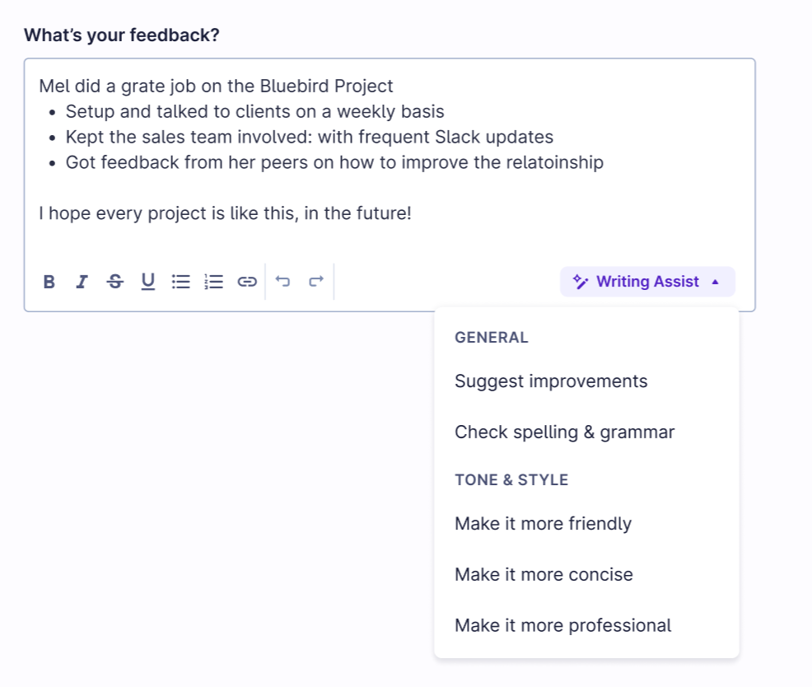
Lattice’s Writing Assist
Lattice’s Writing Assist allows managers and individual contributors to more easily deliver high quality feedback and review responses.
The Writing Assist is embedded within Reviews, Updates, and Feedback
Choose what AI helps with:
Improvements including clarity, readability, bias
Tone & style
Spelling & grammar
All without changing the intended meaning of sentences, removing key facts & information, and personal writing style.

Slide 36
Why use AI for Feedback?
AI is a powerful support tool — not a replacement for your judgment.
Use AI to:
Draft more objective and complete reviews.
Polish language and adjust tone in feedback.
Increase the frequency and quality of coaching moments.
Lattice saw a 40% increase in feedback given when they implemented Writing Assist internally. Other customers saw review writing time go down to as little as 30 minutes per review.

Slide 37
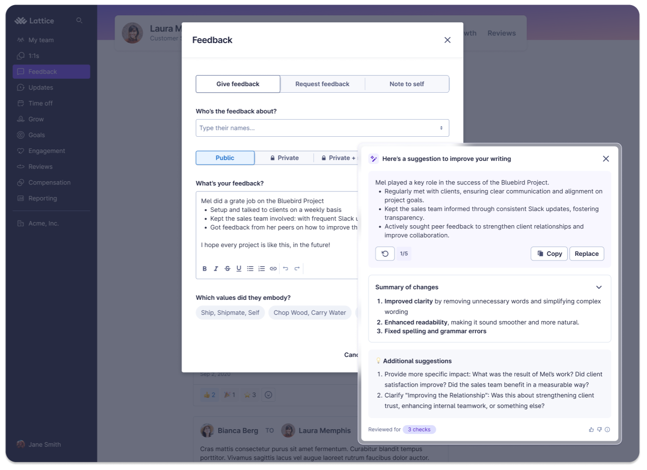
Suggest Improvements
Turning rough drafts into clear messages
Making feedback more specific
removing redundancy or jargon
Leveling up performance review language
Improving flow & structure for calibration
Clarifying feedback for development conversations
Notes:
Turning Rough Drafts into Clear Messages
You start with a quick thought or bullet points — AI restructures it into a more polished, readable draft.
Great for feedback written in a rush that needs better flow.
🔹 Making Feedback More Specific
AI adds detail where your original input might be too vague (e.g., “Did a good job” → “Effectively led the Q2 OKR planning session with clear communication and stakeholder alignment”).
🔹 Removing Redundancy or Jargon
Helps eliminate repetition or overly technical language in review comments, making them clearer and more impactful.
🔹 Leveling Up Performance Review Language
Helps convert casual language into performance-aligned phrasing (e.g., “Worked hard” → “Demonstrated consistent ownership of key responsibilities”).
🔹 Improving Flow & Structure for Calibration
Rearranges and organizes your ideas into a more digestible structure — perfect for feedback that will be reviewed by multiple stakeholders.
🔹 Clarifying Feedback for Development Conversations
When giving coaching-oriented feedback, this helps express ideas in a growth-oriented and constructive way.

Slide 38
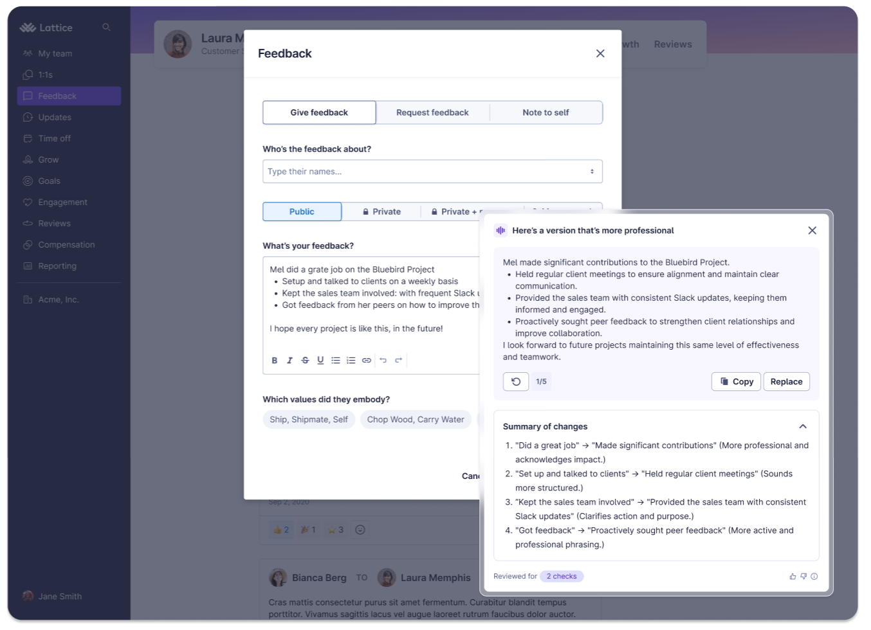
Tone & Style
Adjusting tone for different audiences
Softening constructive feedback
Rewriting emotionally charged drafts
Aligning with company voice
Helping new managers find the right tone
Clarifying feedback for global teams
Notes:
🔹 Adjusting Tone for Different Audiences
More professional for upward feedback or reviews going to execs.
More friendly for peer feedback or team shout-outs.
More concise when word count is limited (like surveys or calibration summaries).
🔹 Softening Constructive Feedback
When delivering improvement feedback, “friendly” or “professional” tone can help avoid sounding too harsh or blunt.
Especially useful in 360s, upward feedback, or manager-to-direct report notes.
🔹 Rewriting Emotionally Charged Drafts
If someone writes a frustrated or overly emotional first draft, tone assist can help neutralize and refocus the message.
🔹 Aligning with Company Voice
Makes it easier to reflect your company’s culture (e.g., warm, direct, encouraging) in performance or feedback language.
🔹 Helping New Managers Find the Right Tone
New people leaders may not yet have a “review voice.” This feature gives them a starting point that feels polished and safe to build on.
🔹 Clarifying Feedback for Global Teams
Tone support helps ensure meaning is clear and culturally appropriate when giving feedback across regions or languages.

Slide 39
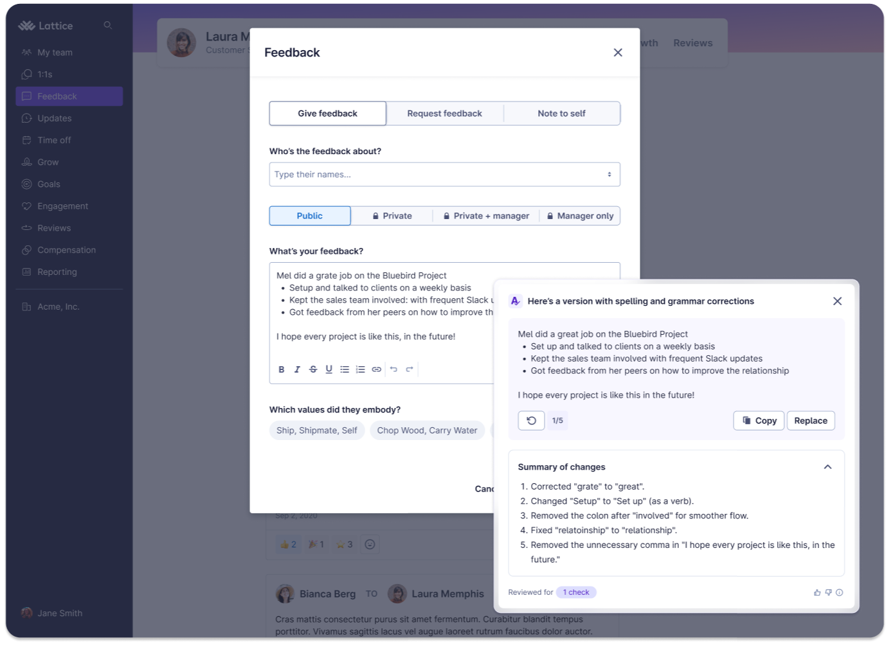
Spelling & Grammar
Polishing feedback for public visibility
Preparing for review calibration
Giving upward or sensitive feedback
Support for non-native English speakers
Streamlining for busy review cycles
Notes:
Polishing Feedback for Public Visibility
When writing public praise or updates in Feedback or Praise modules.
Helps ensure names, achievements, and tone are presented professionally — especially in cross-functional visibility.
🔹 Preparing for Review Calibration
Ensures that written reviews are error-free before they’re seen by peers, HR, or execs.
Reduces the cognitive load of editing — you can focus on the message, not the mechanics.
🔹 Giving Upward or Sensitive Feedback
When writing feedback to a manager or during 360 cycles, it’s especially helpful to have polished, respectful, and clearly worded text.
Correct grammar reinforces clarity and professionalism, avoiding unintended tone issues.
🔹 For Non-Native English Speakers
Makes feedback writing more accessible and inclusive for employees who may be less confident with spelling or grammar in English.
🔹 Streamlining for Busy Review Cycles
Helps when you're drafting a large number of reviews or feedback notes at once — fewer manual edits mean faster, cleaner outputs.
Helps ensure names, achievements, and tone are presented professionally — especially in cross-functional visibility.

Slide 40
Performance Summaries

Slide 41
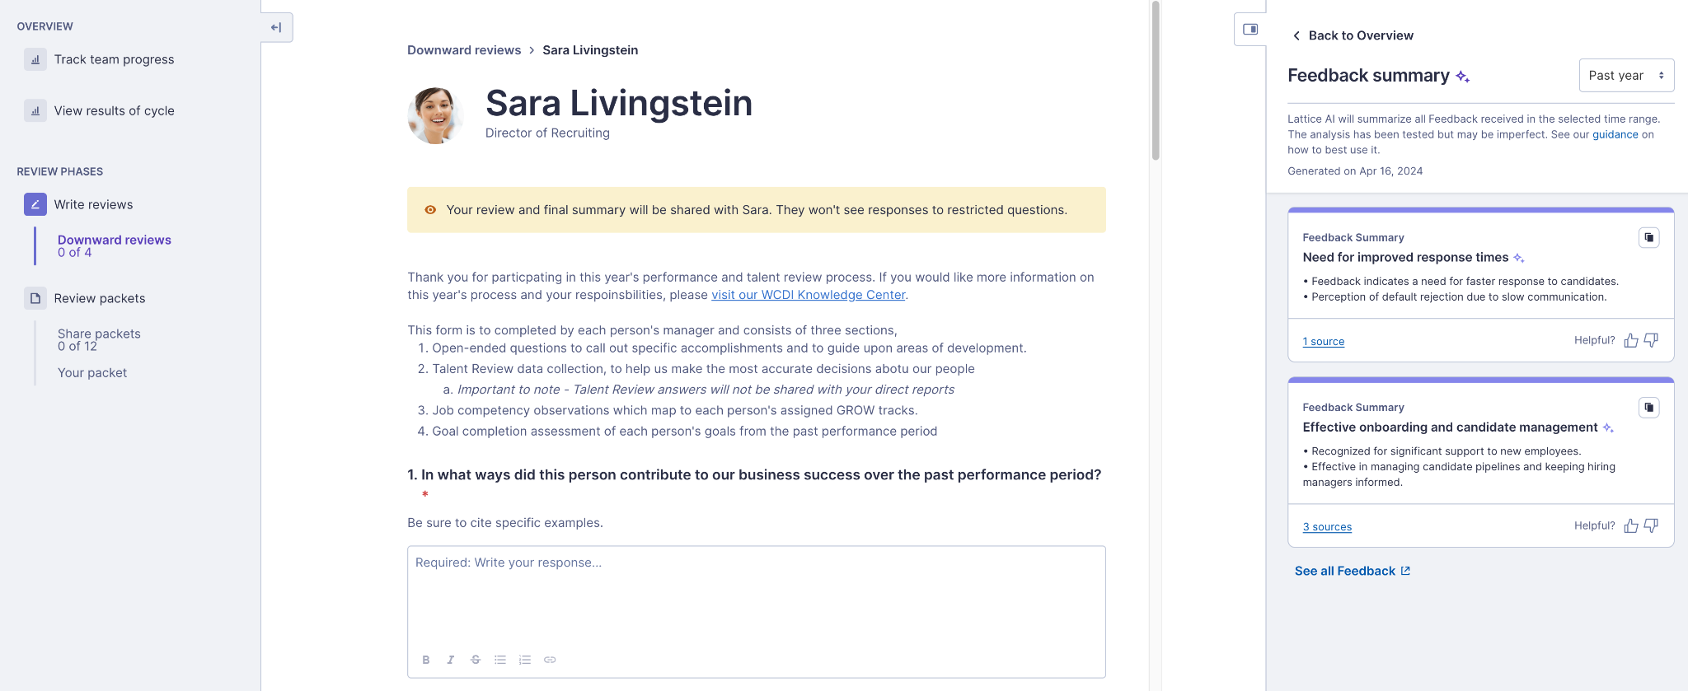
For Managers: AI Performance Summarization
Write better employee performance reviews in less time with personalized suggestions based on Feedback, Grow, and Goals. AI helps reduce recency bias and write more specific feedback.
Notes:
The hardest part about writing employee performance reviews is remember everything that’s happened over the last quarter, 6 months, or year.
Using AI Performance Summarization, managers can get personalized suggestions to include when writing employee’s performance reviews based on goals, feedback, growth areas, and more. This will help managers reduce recency bias and write more specific, meaningful evaluations faster that take the entire review period into account.

Slide 42
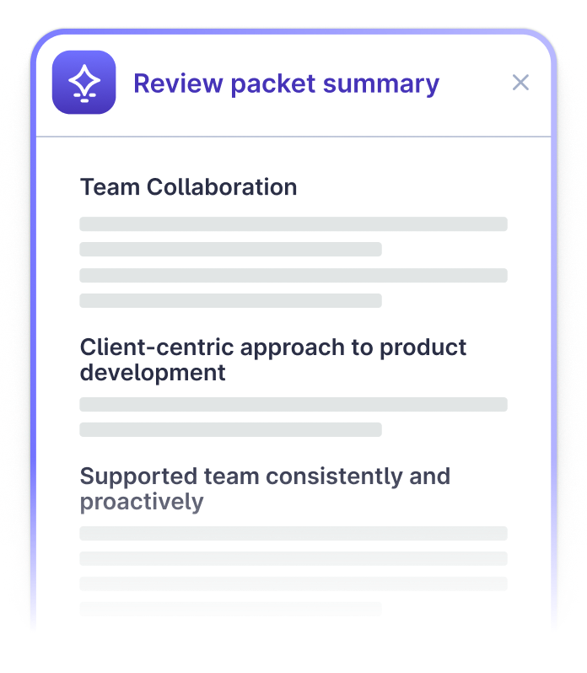
Recommended Growth Areas
Make it easy for your team to get up
to speed on the performance of employees outside of their orbit with Review Packet Summaries to facilitate more productive, informed, and unbiased discussions during calibration sessions.

Slide 43
Recommended Growth Areas

Slide 44
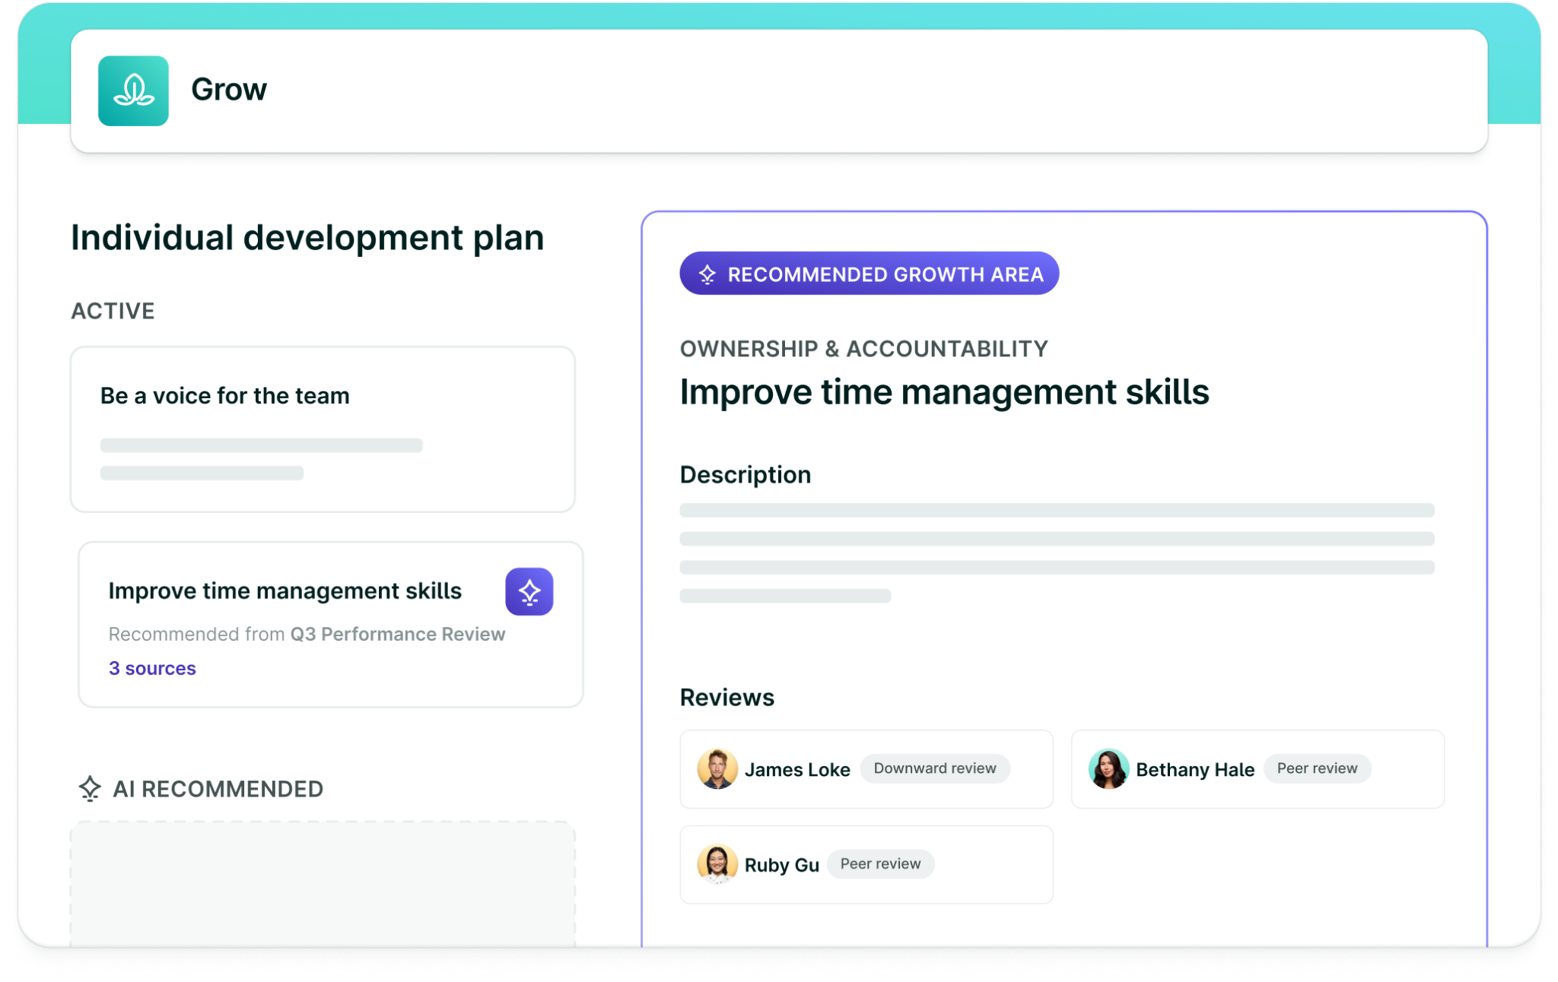
Recommended Growth Areas
Supercharge employee development with personalized, recommended growth areas based on feedback, reviews, and goals.
Employees can refine these recommendations, driving employee engagement and developing their talent faster.
Notes:
The hardest part about writing employee performance reviews is remember everything that’s happened over the last quarter, 6 months, or year.
Using AI Performance Summarization, managers can get personalized suggestions to include when writing employee’s performance reviews based on goals, feedback, growth areas, and more. This will help managers reduce recency bias and write more specific, meaningful evaluations faster that take the entire review period into account.

Slide 45
Engagement Insights

Slide 46
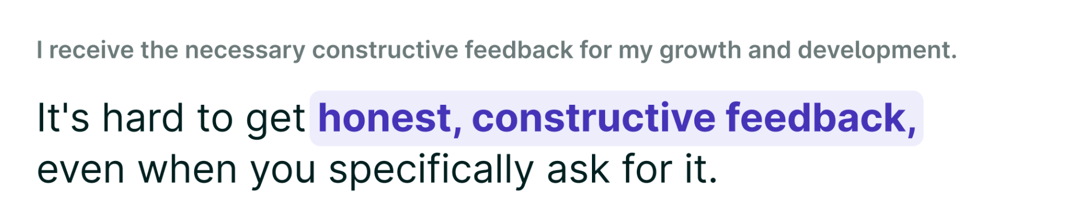
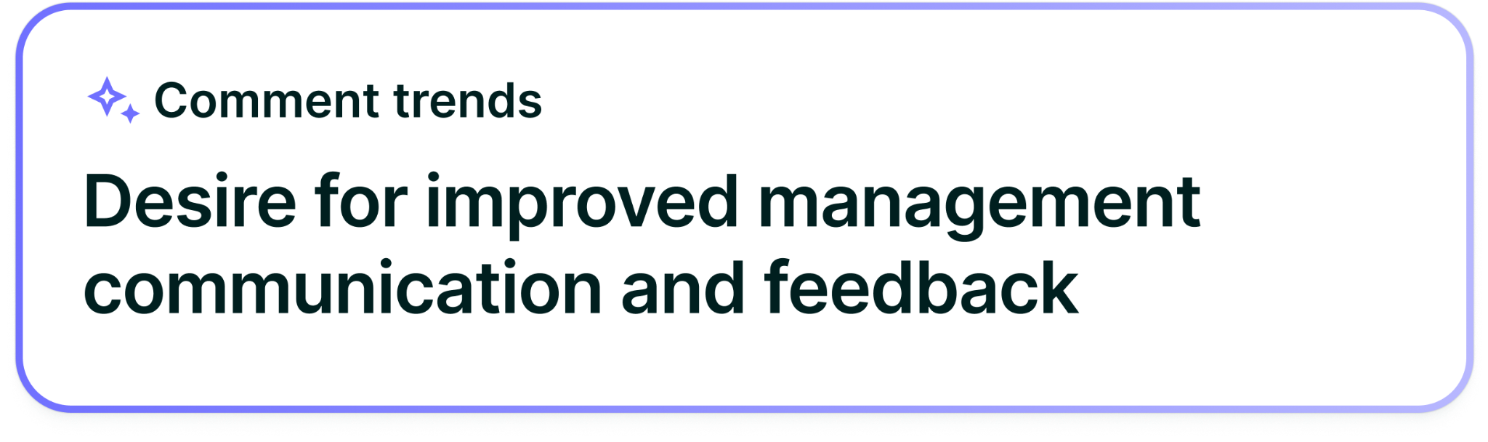
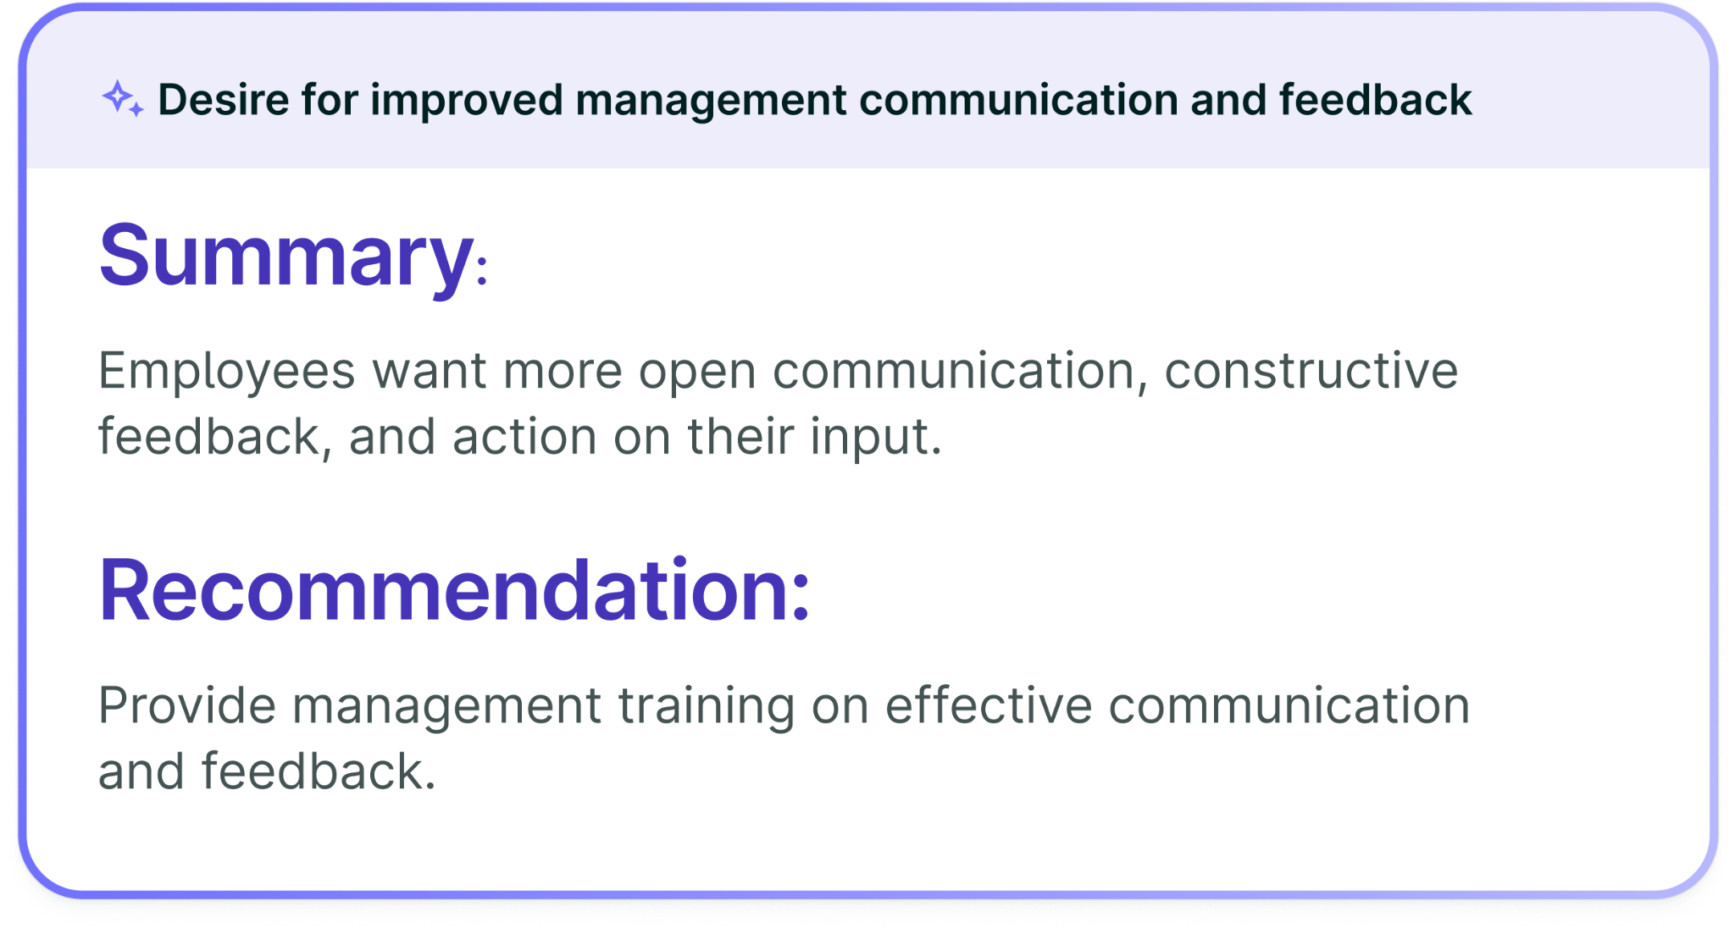
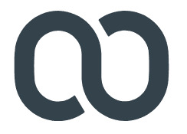
Lattice AI
Engagement Survey Insights
Identify key drivers and summarize comments without manually pouring over extensive data to get to action planning faster.
“Not only is there time saved but there's also consistency from the analysis ensuring we all see the results the same way.”
Mike Brutinel,
Head of People Operations, Weave
Notes:
Engagement surveys are one of the best opportunities for People Leaders to collect candid employee feedback on their experiences. However, once the survey is closed, it can take admins weeks to read through all of the comments, synthesize information into themes, determine how to action, and prioritize that action for impact.
Our new AI Engagement Insights tool reduces that time down to seconds by delivering an almost immediate understanding of top trends and recommended action items once the survey has been closed.
While AI can't replace the nuanced understanding gained from reading each comment, it is a great tool for gaining a quick understanding and additional context behind your engagement scores. This ensures a more comprehensive and consistent approach to addressing employee feedback, empowering HR leaders to efficiently make informed decisions that truly resonate with their workforce's needs and concerns.

